Slide 1
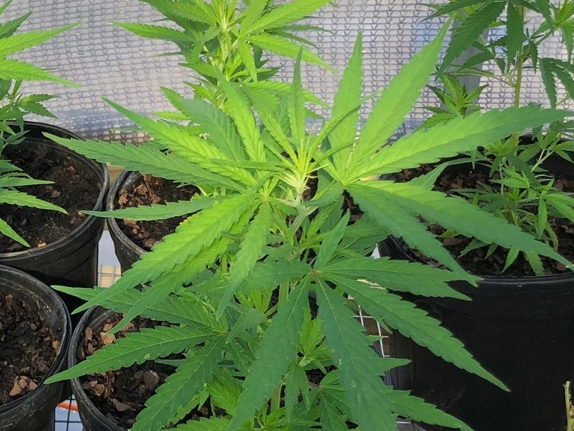
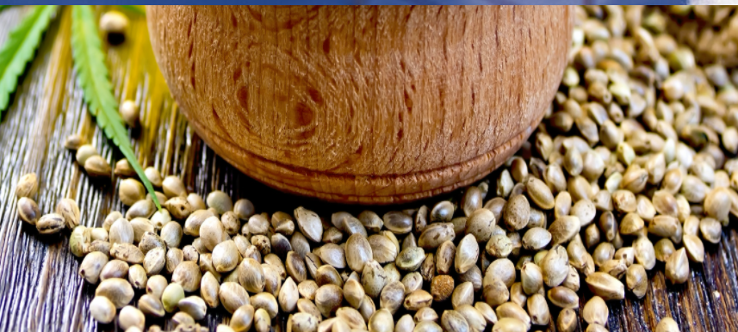
Hemp Material Acquisition Process
Gail M. Ellis, Program Manager
Alabama Department of Agriculture & Industries

Slide 2
SEED/PROPAGULE ACQUISITION REQUIREMENTS
Growers should know what they are growing hemp for before they submit an application for license (i.e., oils, fiber, grain, seeds, floral, etc.)
Growers should have already researched hemp material sources (seeds and/or plant materials) before they submit an application for license.
Each Grower must wait to purchase and receive materials until they receive an ADAI approval email, via Outlook, for the source(s) and varieties they intend to purchase.
Growers are required to submit an online Seed/Propagule Acquisition form for each source they intend to purchase from. A new source and/or variety requires submission of another form.
1) List Grower information
2) List Source information
3) List Variety names for this Source

Slide 3
SEED/PROPAGULE ACQUISITION REQUIREMENTS continued
Growers will not be required to collect their source’s license documents or their COA documentation.
ADAI Hemp Program staff will collect the source’s required license documents.
1) Direct Source and Broker Sources - A direct source grows seeds/plant; broker source
handles seeds/plants that someone else grew. Ask your source which one they are.
2) In-state and Out-of-State All sources are required to provide hemp licenses, seed registration/dealer permits, nursery grower permits.
The ADAI Food and Drug Lab staff reviews and verifies validity of all COA
documentation for each variety.
1) Certificate of Analysis (COA) showing that the material grown from
the seeds/propagules has no more than 0.3% THC.
2) Linking documents back to original grower. (Broker transactions)

Slide 4
SEED/PROPAGULE ACQUISITION REQUIREMENTS continued
University Hemp Material Acquisitions:
Transfer of hemp materials between Universities must include the Seed/Propagule Acquisition Request that lists one university as the licensee and lists the other university as the source. Complete the acquisition request to include the variety names, quantities, type of material, etc.
These acquisition requests must be vetted through the ADAI lab just as any other acquisition request:
The source will be required to provide license documents from the state they are in.
The source will be required to provide COA documentation.
2. Acquisition of hemp materials from a licensed grower to a university must include the Seed/Propagule Acquisition Request that lists the university as the licensee and lists the licensed grower as the source. Complete the acquisition request to include the variety names, quantities, type, etc.
These acquisition requests must be vetted through the ADAI lab just as any other acquisition request:
ADAI will have license documents, and should have COA documentation, for the licensed AL grower
Any research agreement between a university with other licensed growers must be included in the university’s research plan. Those plans must include the licensed grower’s name/company name, license number, site information and the specifics of the research being conducted.
If a university creates such agreements throughout the year, updated research plans must be submitted to ADAI.

Slide 5
SEED/PROPAGULE ACQUISITION REQUIREMENTS continued
ADAI Hemp Program staff will issue the acquisition approval emails to each grower/university.
One grower/university cannot purchase a variety from a source that has been approved for another grower/university. Each grower/university must submit acquisition requests and follow acquisition procedures.
You can request a pro forma invoice from your source before you make any purchase. A pro forma invoice is a preliminary bill of sale
After receiving your hemp material, you must upload both ordering AND receiving documents.
All documents should include, but not be limited to, the source and buyer information (i.e., contact name, company name, license #, address, phone number, etc.), variety names, amount of seed/number of plants purchased, type of material, date(s) of transaction.
Each transaction must be documented and uploaded.
What constitutes a new transaction? New variety from same source; or a new source;

Slide 6
DOMESTIC & INTERNATIONAL SEEDS
DOMESTIC SEEDS: At this time, most domestic seed varieties (seed varieties that have been grown and harvested in the US) are able to be submitted to ADAI for acquisition review/approval.
One Variety of Concern: Oregon Cherry This variety will not be approved
INTERNATIONAL SEEDS: ADAI established procedures for licensed Alabama hemp growers to directly acquire international seed varieties in March 2021. Growers must obtain the two forms related to international seed acquisition via the website at https://agi.alabama.gov/hemp/wp-content/uploads/sites/11/2022/03/hemp_international-seed-acquisition-form-2022.pdf on the “Resources” page under “Program Information.” Or, by requesting copies at ALHemp@agi.alabama.gov.
The listed source will be required to submit licensing documents and Certificates of Analysis in English to ADAI. Growers need to be prepared for some delays in ADAI obtaining all required source documents.
NOTE: There are many delays on the source’s end due to not having all license documents in order prior to intended sales, or in having all COA documents and linking documents required by the AL Food and Drug Lab

Slide 7
GROW PLAN REPORT AND PRODUCTION REPORTS
You are required to submit an initial Grow Plan for each grow site, before planting, that includes:
Any changes to the original application information
Total number of acres to be planted
Total number of square feet to be planted
Name, quantity, and type of each variety to be planted
Estimated timeline for harvest
The location where material will be stored or sold
As changes/additions occur to your plan, you must submit an another Grow Plan reflecting those changes and/or additions. You are required to submit an updated Grow Plan each time there are changes and/or additions throughout the growing season.
You are required to submit a Production Report each time you plant at each site.
Site name & GPS, planted acres or square feet, varieties planted, type of material planted, date planted, etc.

Slide 8
Harvest/Destruction Form
You must notify ADAI 14 days before each harvest to allow inspectors time to schedule a day to sample.
You must have a Grow Site Planting Diagram present at inspection. Inspectors are required to collect a copy.
Your up to 30-day window to harvest begins the day we sample. Harvest as whole plants! Take to licensed drying/storage site until ADAI notifies you of Release/Movement.
You must notify ADAI 14 days before any destruction to allow inspectors time to schedule a day to sample/witness the materials to be destroyed. ADAI must witness the destruction. (You are allowed to compost rogue males, skips, etc., however, document the losses.)
You MAY NOT sell or move your harvested material to a processor until after you receive your Release/Movement form and the final lab analysis results from ADAI.

Slide 9
EXAMPLE OF A GROW SITE PLANTING DIAGRAM

Slide 10
Sampling and THC Testing
Total Delta 9 THC is the sum of Delta 9 THC and Delta 9 THCa corrected for molecular rate.
All growing sites will be inspected and sampled prior to harvest or destruction by ADAI inspectors. This includes licensed Nursery Growers.
Samples will be taken of each plot and variety/strain.
THC test results may take up to 6 weeks. ADAI tries to keep this within 8 days. Allow for 6 weeks.
Grower or knowledgeable representative must be present for site visits, inspections and sampling. ADAI must be notified of all representatives prior to times of inspections.
Additional pre-harvest sampling fees will be assessed for each sample, each variety. You will be emailed an invoice for these samples and have 30 days to make payment.

Slide 11
POST-HARVEST REPORT FORM Year End Report
You are required to complete and submit this report for every approved grow site even if:
Your 2023 Grower license was voided or revoked.
You did not grow anything for 2023.
Your crop was destroyed (weather, insects, etc.)
You did not harvest anything because you are growing clones. Licensed Nursery Growers
You are not applying for a 2024 Grower license.
This report is due before February 1, 2024.

Slide 12
Communication
Primary method of communication is email via Outlook, and/or from Kellyreg.com.
Email is the chief way that we will contact you, and it is the best way to reach us.
Be sure that the email address you provide is one that you check frequently. If you change your email address at any time, you are required to notify ADAI immediately via email.
Our general email address is ALHemp@agi.alabama.gov
If you receive a CERTIFIED LETTER from us, it is IMPORTANT that you accept it and sign for it. If it does not return to us ‘unclaimed,’ ‘attempted unknown,’ etc. we consider that as delivered. Not accepting a Certified Letter from ADAI does not remove your responsibility for what is included in the communication.
Phone calls: If you don’t leave a phone number, we will not return your call.
DO NOT have someone who is not already listed as a contact person, or representative, for you try to communicate with us about you or the license issued with you as the primary contact. We will not talk to them!
Type/write clearly; do not type in all caps or all lowercase letters; check spelling, etc.

Slide 13
When you have Questions….
Carefully READ all emails/letters from ADAI and/or KRS
Check your SPAM folder - Example of KRS email: ALHempGrowerNewApp @kellyreg.com
DON’T PANIC! R-E-A-D it again – to the end!
Then respond to what the email/letter is telling you to do.
Check the ADAI website for updates on the hemp pages regularly.
Email or call a member of the hemp administrative staff:
Gail Ellis gail.ellis@agi.alabama.gov 334-240-3713
Pamela Barberi pamela.barberi@agi.alabama.gov 334-240-7270
Cari Dennis cari.dennis@agi.alabama.gov 334-240-7230
Macie Ellis macie.cooper@agi.alabama.gov 334-240-7271

Slide 14
At Your Own Risk
Limited production information
Uncertain federal regulatory environment
Unstable pricing
Limited crop insurance
There are no guarantees!

Slide 15
Any Questions?

