Slide 1
NASDA & NASDA Public Engagement
Sarah Grace Fowler
Director, Communications

Slide 2
About NASDA
NASDA enhances American food and agricultural communities through policy, partnerships

Slide 3
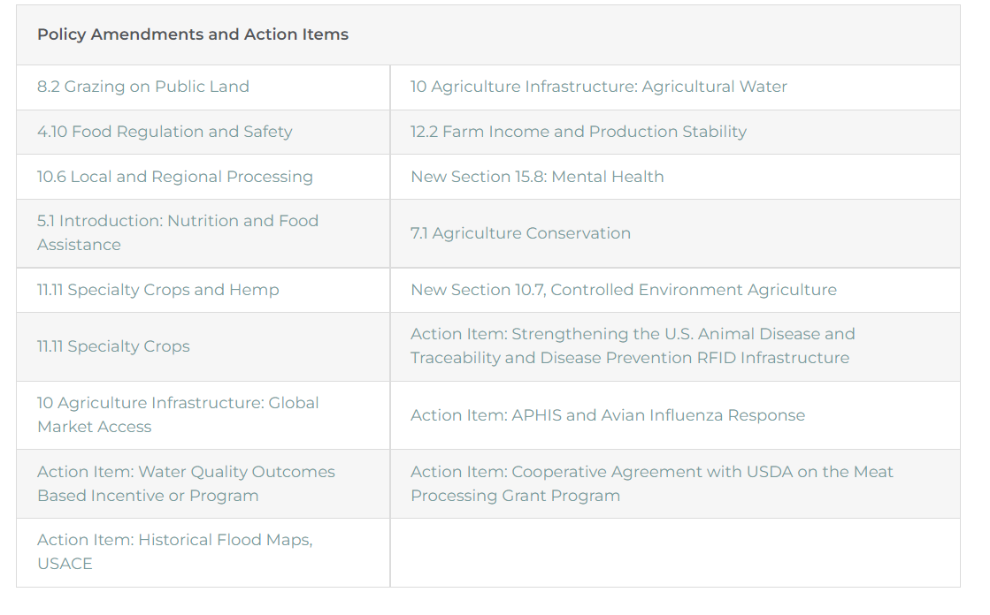
Policy Updates
Annual Meeting
2023 Farm Bill
Farm Bill priorities & one pager

Slide 4
NASDA Communications & Public Engagement Goals
Strategic Goal: Expand the reach of NASDA’s influence and shine a positive light on the important work done by state departments of agriculture on behalf of consumers.
Supports NASDA strategic plan developed by NASDA members
Strategic Plan Update
Doubled social media engagement
Increased news media reach by 27%

Slide 5
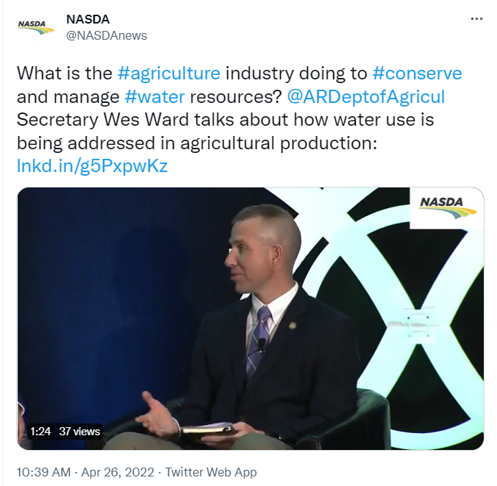
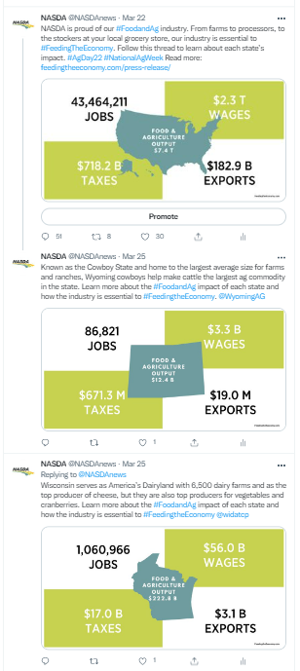
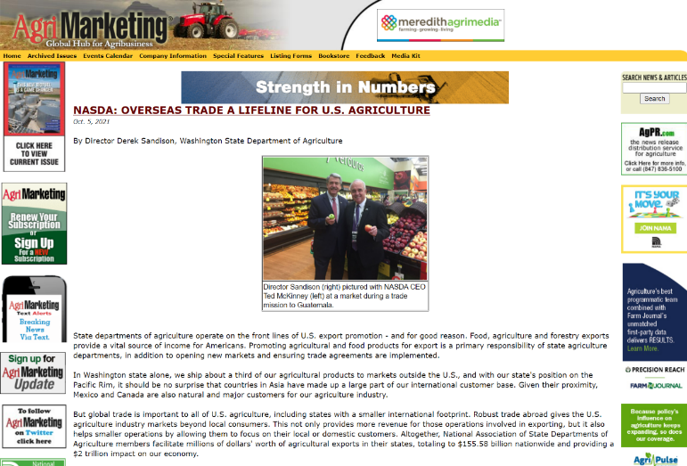
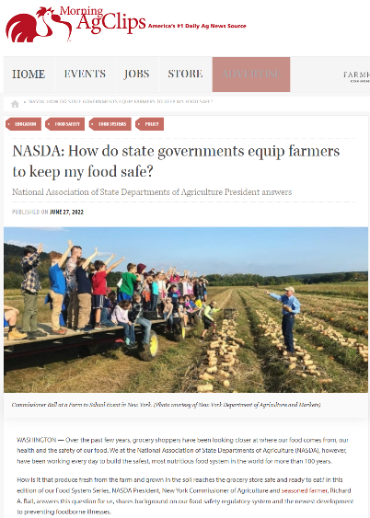
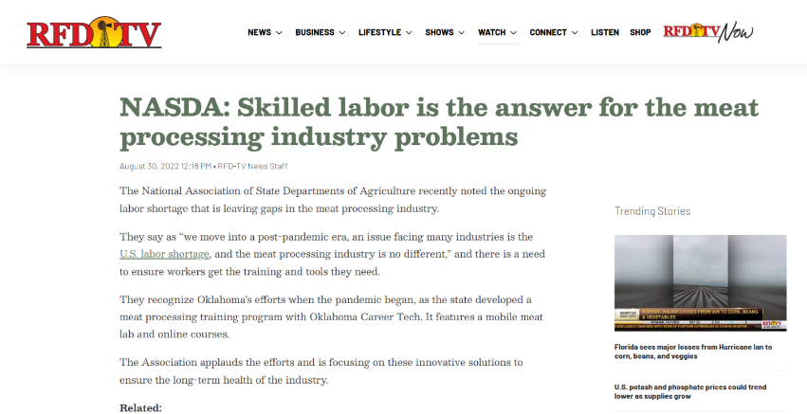
Thank you!

Slide 6
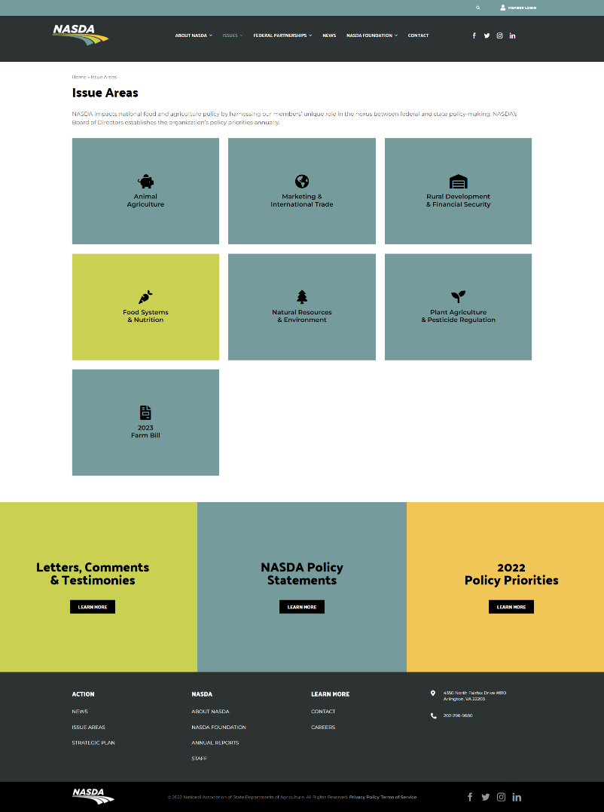
New NASDA.org

Slide 7
Q4 Topic – Trade Oct-Dec 2022
Purpose/Goal
Demonstrate expertise
Awareness/education
Influence policy
Audiences
Trade and food focused organizations & businesses
Policymakers (urban and rural)
Lead Tactic
Blog & Newsletter feature series
Miami Tradeshow
UK Emerging Markets Trip
Tri-National Agricultural Accord

Slide 8
Ending thoughts
Public engagement fuels our policy advocacy which serves your states.
Let’s stay connected! Telling stories about the impact of state agriculture departments across the nation depends on our teamwork. How else can NASDA be supporting your communications efforts?

Slide 9
Contact me
Sarah Grace Fowler Director, Communications National Association of State Departments of Agriculture sarah.fowler@nasda.org 571-447-5398

