Slide 1
Grant Communication
Farmer Stress Assistance

Slide 2
USDA NIFA Grant
Farmer and Rancher Stress Assistance – SDA
$500,000 per state
Only eligible entity in Idaho
Very quick timeline
Creating a scope
Stress management/mental health
Financial management
Transition planning

Slide 3
Grant Activity
8 stress management trainings
8 financial management training
10 transition planning and critical conversation trainings
1 large-scale statewide conference
Education & outreach
Staffing
Media campaign

Slide 4
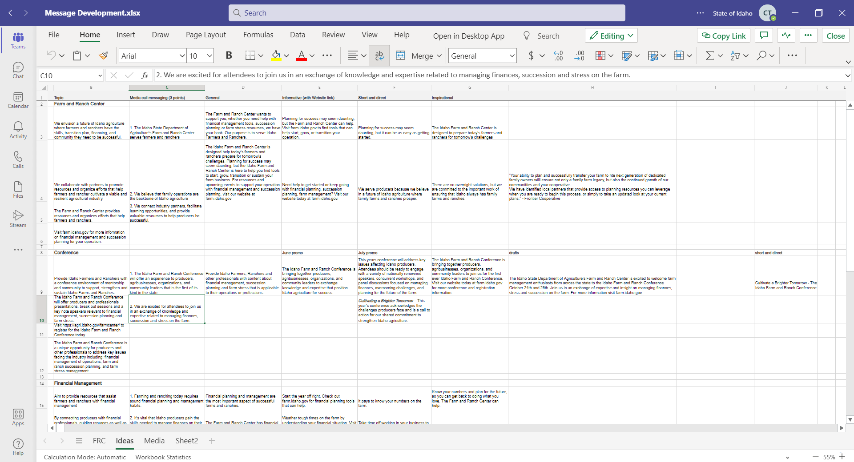
Message Development

Slide 5
Farm stress videos
Working with an ad firm
Finding the right participants
Pushing for a particular vision
Firmness on ag nuance & messaging
Ongoing work with final editing

Slide 7
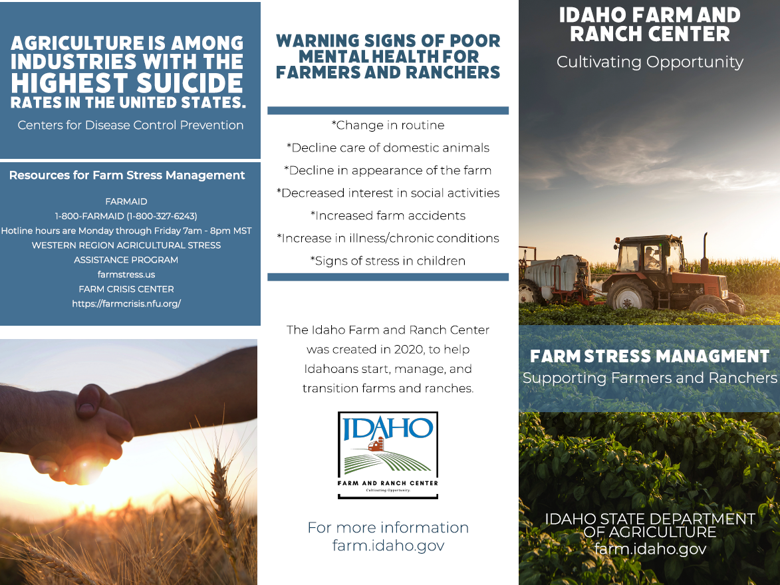
Printed Resources

Slide 8
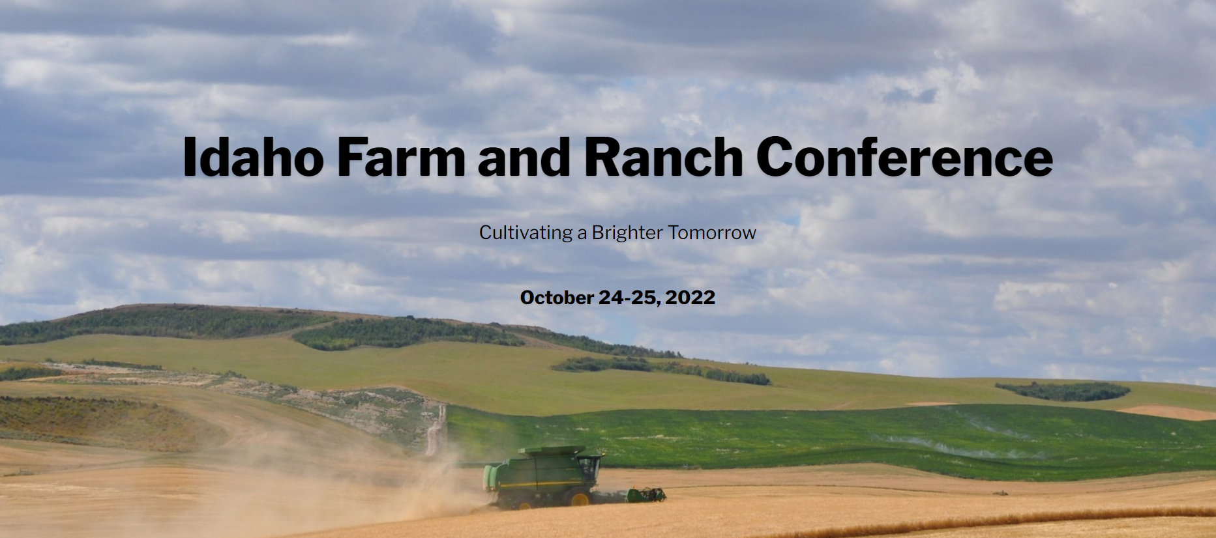

Slide 9
First Conference
Working to bring attention to a new event
Challenges finding speakers
Ensuring consistency in messaging

Slide 10
Key Takeaways
Understand your resources, proximity and availability
Hiring challenges
Huge degree of contracting and subcontracting
Limited staff
Fewer activities
Double checking every message for tone and scope
Evergreen resources
Long-term benefit for the whole program

