Slide 2
THE FOREST WORKFORCE TRAINING
INSTITUTE (FWTI) WAS FOUNDED IN 2018 TO HOUSE WORKFORCE DEVELOPMENT INITIATIVES
FORMERLY UNDER THE ALABAMA FORESTRY FOUNDATION.

Slide 3
ABOUT US
ForestryWorks® is the promotional brand of the Forest Workforce Training Institute.
ForestryWorks® goal is to educate students, parents, and teachers about careers and job opportunities in the forest industry, and provides interested individuals with resources to help them along their career path.

Slide 4
OUR GOAL
Create a pipeline of qualified workers for the forestry and forest products manufacturing industry

Slide 5
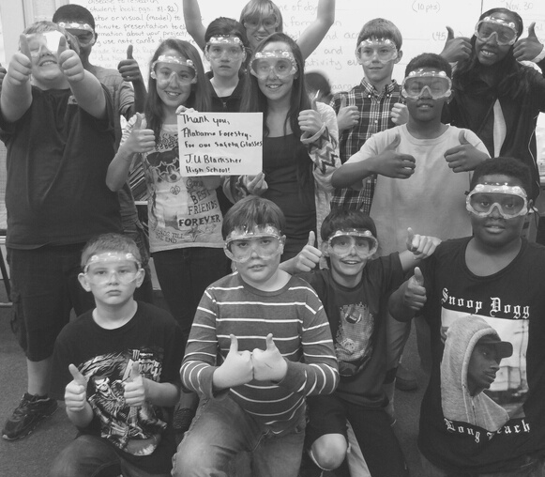
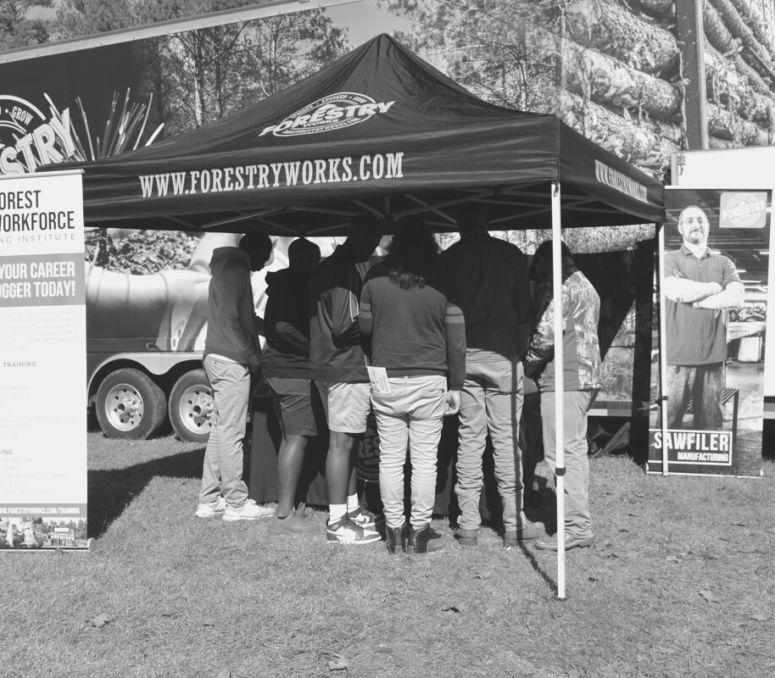
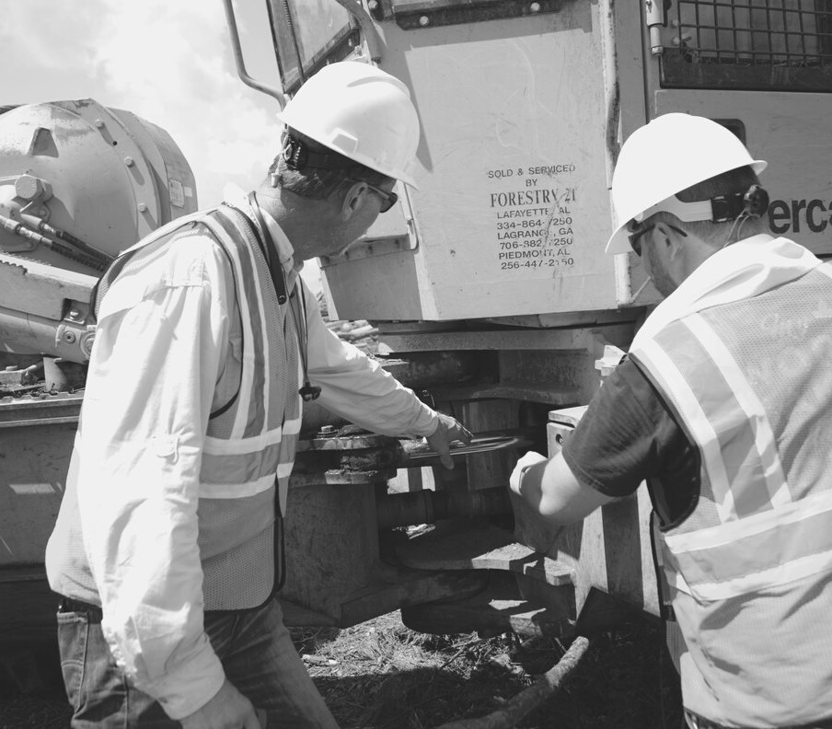
THE STRATEGY
CAREER PROMOTION
EDUCATION
TRAINING

Slide 6
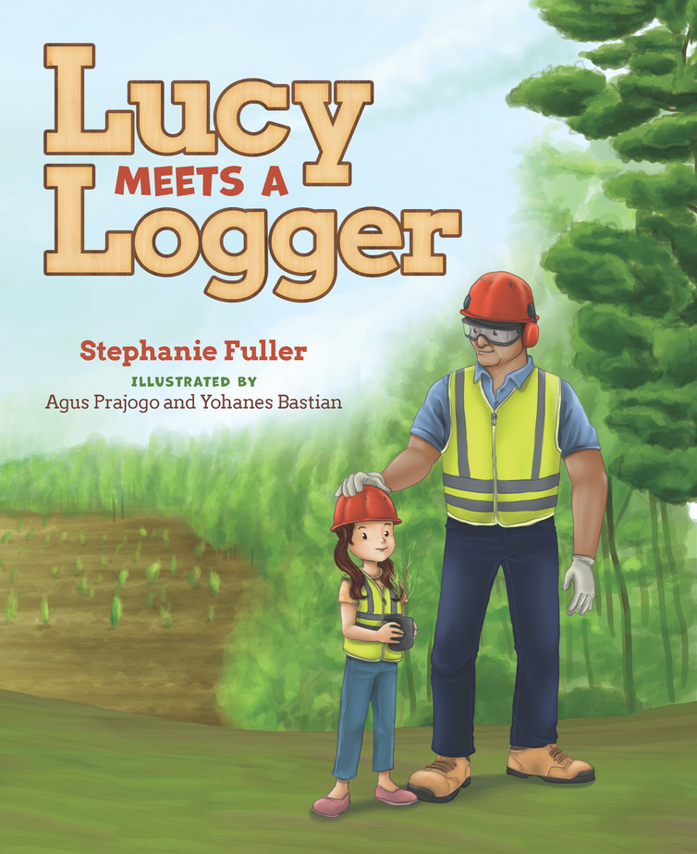
EDUCATION
- forestry field days
- classroom visits
- Tiny Timber Crew series™

Slide 7
CAREER PROMOTION
- forestry career days
- career fairs
- ForestryWorks® job board
- truck driver recruitment campaign
- digital and social media campaigns
WWW.FORESTRYWORKS.COM

Slide 8
TRUCK DRIVER RECRUITMENT CAMPAIGN
- launched in 2020
- digital and social media campaign designed to target long haul drivers
- "drive during the day, be home at night"
- 124 drivers referred in Alabama
https://www.forestryworks.com/log-truck-driver-recruitment

Slide 9
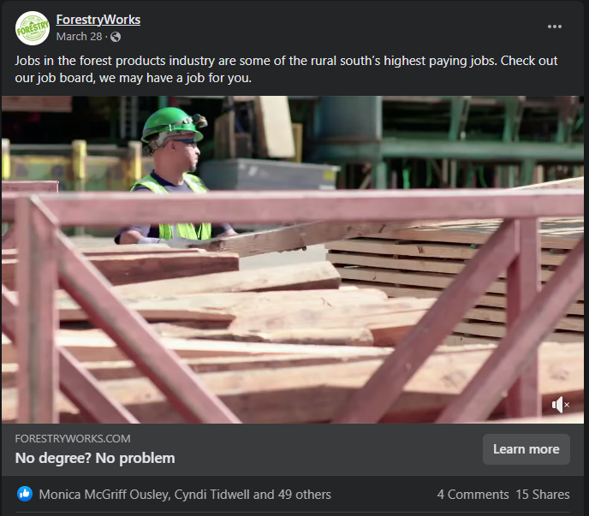
SOCIAL AND DIGITAL MEDIA MARKETING
4.5 million people reached through digital marketing in 2021
(Google, Bing, etc)
1.2 million people reached through social media marketing in 2021
(Facebook, LinkedIn, Instagram, YouTube, TikTok)

Slide 10
TRAINING
- logging equipment operator training program
- safety training
- log truck driver training (in development)
- workforce development forum

Slide 11
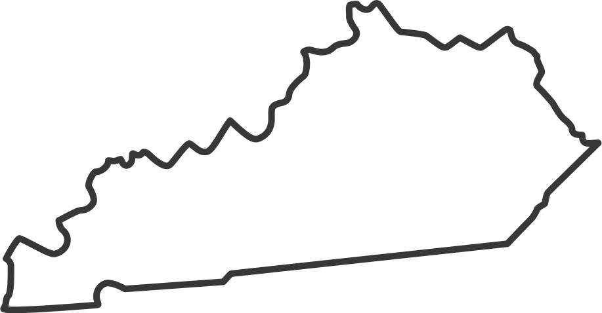
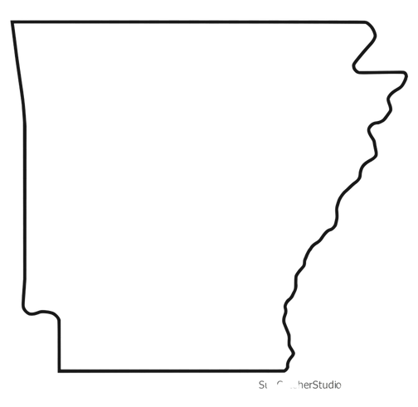
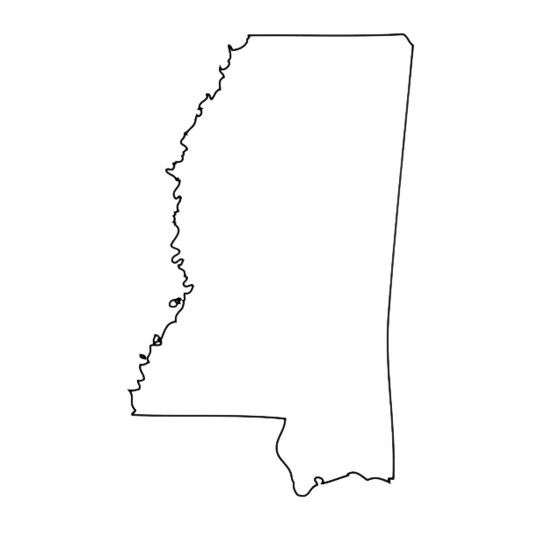
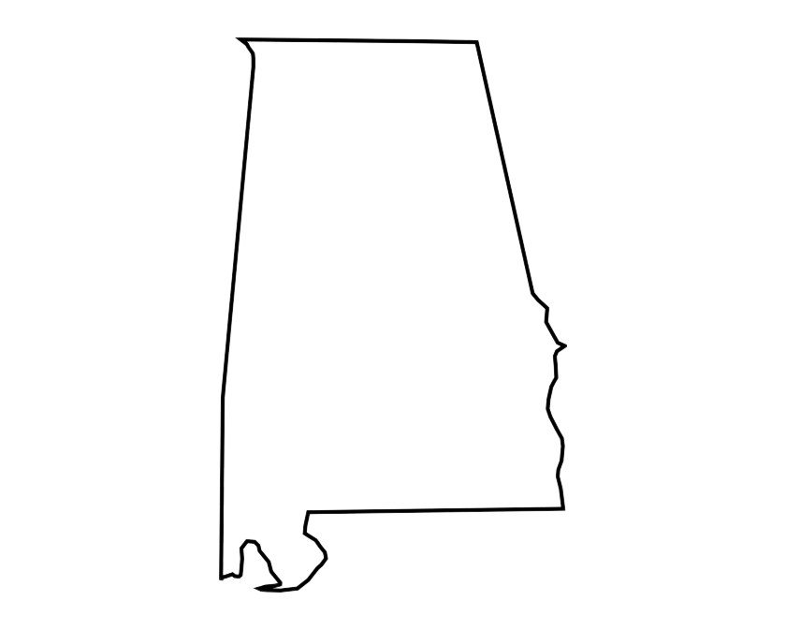
REGIONALITY
ForestryWorks® programs, branding and materials were designed to be utilized in all southeastern states
state affiliates:
- Alabama
- Arkansas
- Mississippi
- Tennessee
- Kentucky

Slide 12
STEPHANIE FULLER, DIRECTOR OF PROMOTIONS AND ECONOIC DEVELOPMENT
FOREST WORKFORCE TRAINING INSTITUTE (FORESTRYWORKS)
SFULLER@ALAFORESTRY.ORG
706-590-2868

