Slide 1
Instagram reels & TikTok Videos for State Departments of Agriculture
By Jenny Green
Communications Specialist

Slide 2
Staying Relevant on social media
Agency platforms: “Education before regulation” approach. Sometimes the information is boring and there’s no way around it!
Marketing platforms: “Sparkly” content
Short-form video is more important than ever!
TikTok
Instagram Reels
Content that gets followers is Liked, Shared, & Saved by viewers

Slide 3
Timing is everything
Length of video
When to post
What’s ideal?
TikTok: 10-30 seconds
10 minutes max
IG Reels: under 1 minute
90 seconds max
TikTok:
Early morning, late evening
IG Reels:
Late morning, early evening

Slide 4
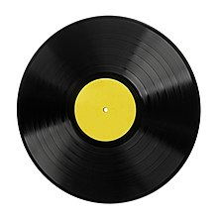
Content breakdown
Side A: NMDA
Industry updates
Reminders for meetings/webinars/hearings
Regulation & policy
News from University Cooperative Extension, industry pages
“Did You Know?” e.g. stats, ag/state history
“This Is What We Do” /
“A Day in the Life”
Side B: Taste the Tradition
Local and international events, international trade
Holiday season
Chef ambassadors
Recipes
Farmers’ markets
Buy local campaign
Specialty crops
National Days & Months
Social media is “double-sided,”
much like a record.
Don’t know where to start with TikToks & Reels? This content can easily be shown in 10 to 30 seconds.

Slide 5
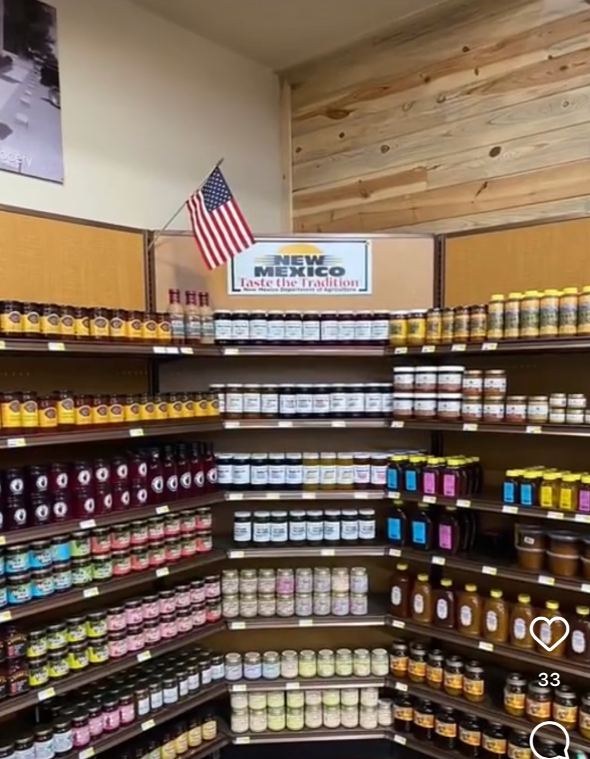
TIKTOK Example #1
Promoted this year’s $5 Challenge campaign
1,709 views, 63 likes, 1 share
Under 10 seconds

Slide 6
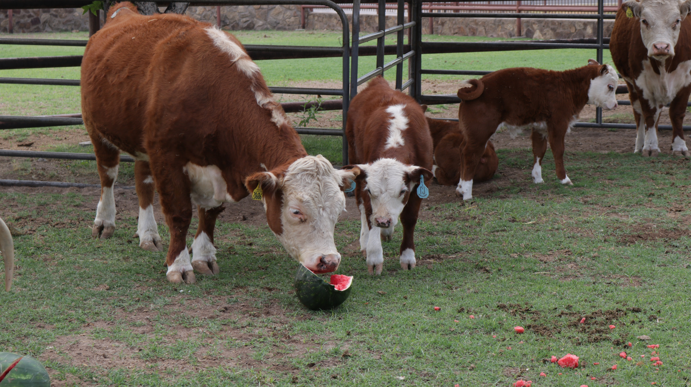
TIKTOK Example #2
In celebration of National Cow Appreciation Day
Features Agriculture Secretary
852 views, 42 likes, 1 save
Under 20 seconds

Slide 7
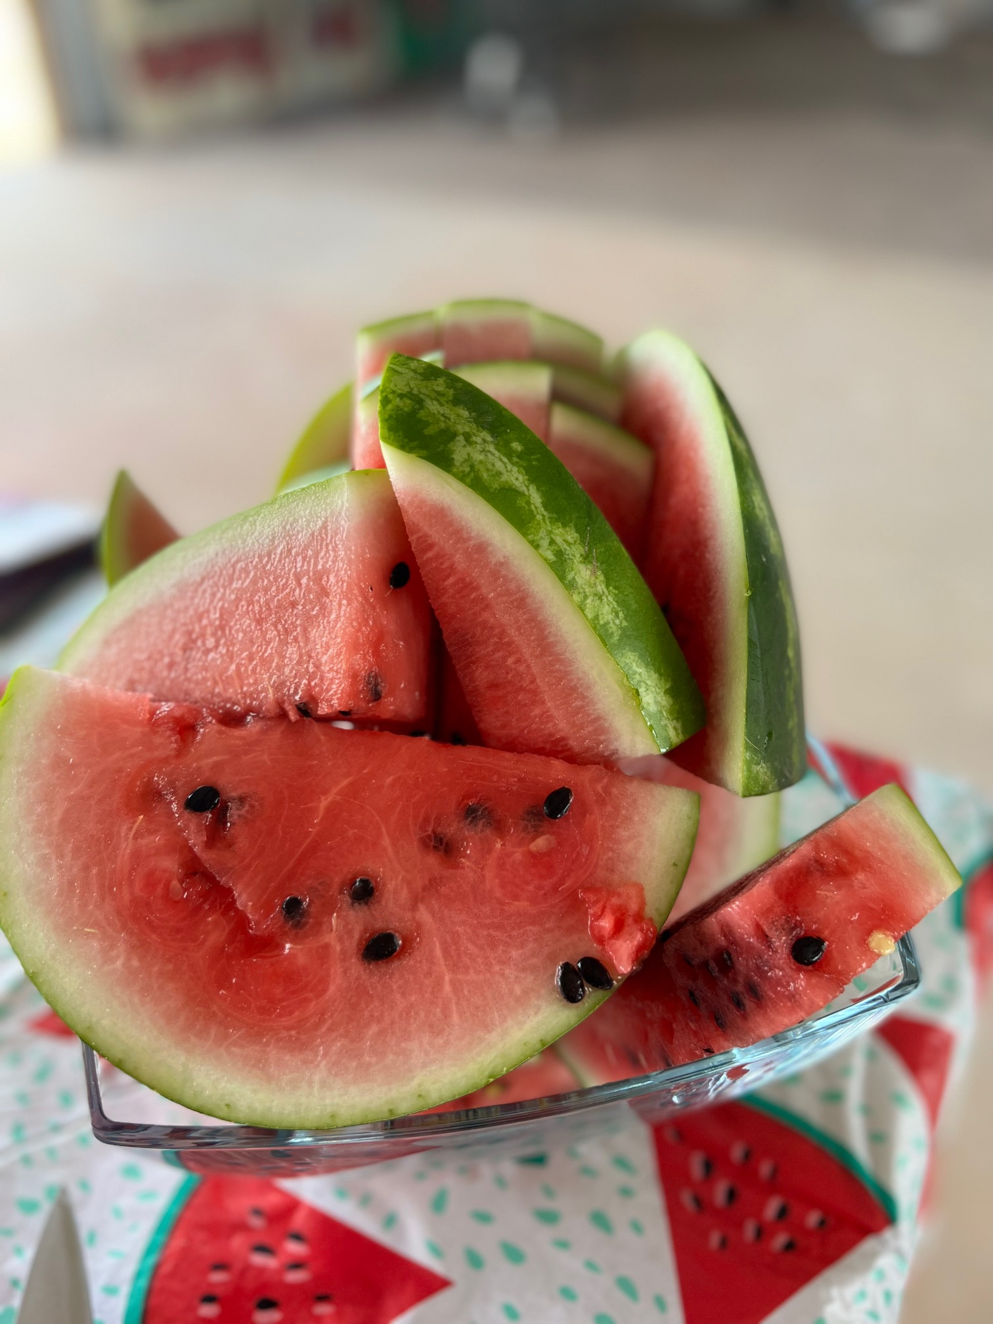
REEL Example #1
TTT collaborated with a local farm to promote National Watermelon Month.
5,700 views, 117 likes, 8 shares, 5 saves
Under 1 minute

Slide 8
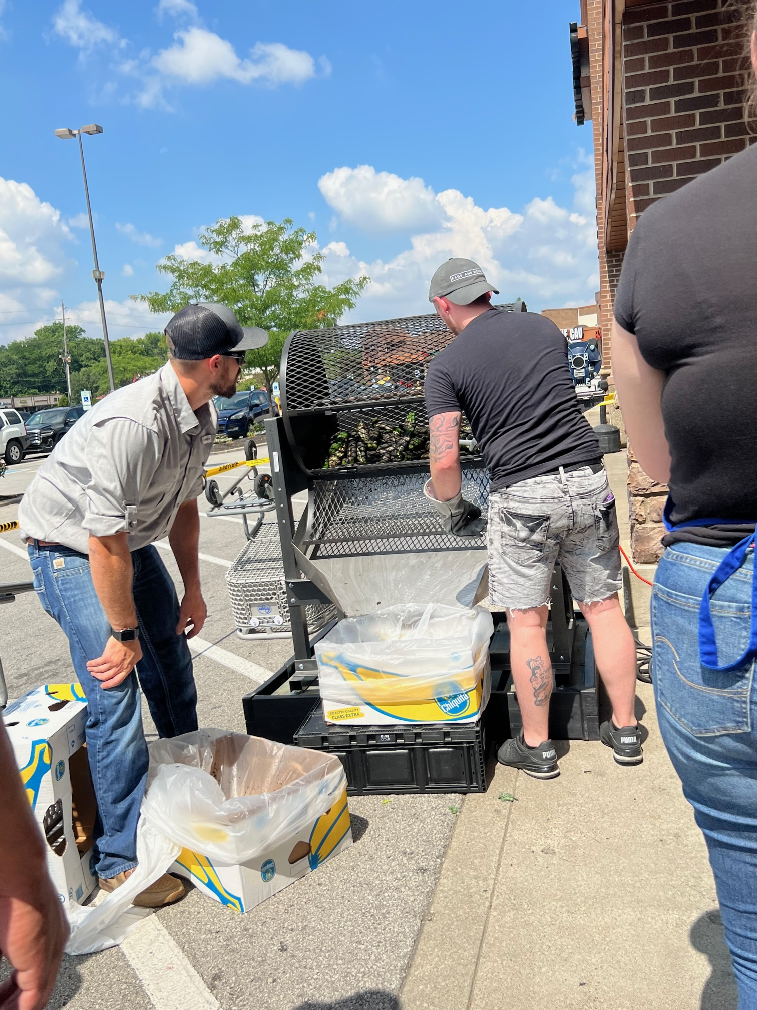
REEL Example #2
Example of “This Is What We Do” content.
Demonstrates outreach
5,508 views, 205 likes, 17 shares, 3 saves
Under 1 minute

Slide 9
Impact
TikTok
IG Reels
From June to July, followers increased from fewer than 100 to over 750. 11 videos were posted.
Likes increased from ~400 to nearly 6,700.
From June to Aug., followers increased by ~200.
TikToks reposted as reels performed well, but original reels performed better.
Likes and content views increased approx. 130%.

Slide 10
Questions?
Contact Information
Jenny Green
Communications Specialist
jgreen@nmda.nmsu.edu
Office: 575-646-3060
Work Cell: 575-202-4249

